Slide 1
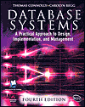
Lecture Four
Database Planning, Design,
and Administration
Based on Chapter Nine of this book:
Database Systems: A Practical Approach to Design, Implementation and Management
International Computer Science S.
Carolyn Begg, Thomas Connolly

Slide 2
Lecture 4 - Objectives
Main components of an information system (IS).
Main stages of database systems development lifecycle.
Main phases of database design: conceptual, logical, and physical design.
Benefits of CASE tools.
How to evaluate and select a DBMS.
Distinction between data administration and database administration.
Purpose and tasks associated with data administration and database administration.
2
Notes:
September 98
2
Lecture Name

Slide 3
Information System
Resources that enable collection, management, control, and dissemination of information throughout an organization.
Database is fundamental component of I.S., and its development/usage should be viewed from perspective of the wider requirements of the organization.

Slide 4
Database Systems Development Lifecycle (DSDLC)
Database planning
System definition
Requirements collection and analysis
Database design
DBMS selection (optional)

Slide 5
Database Systems Development Lifecycle
Application design
Prototyping (optional)
Implementation
Data conversion and loading
Testing
Operational maintenance.

Slide 6
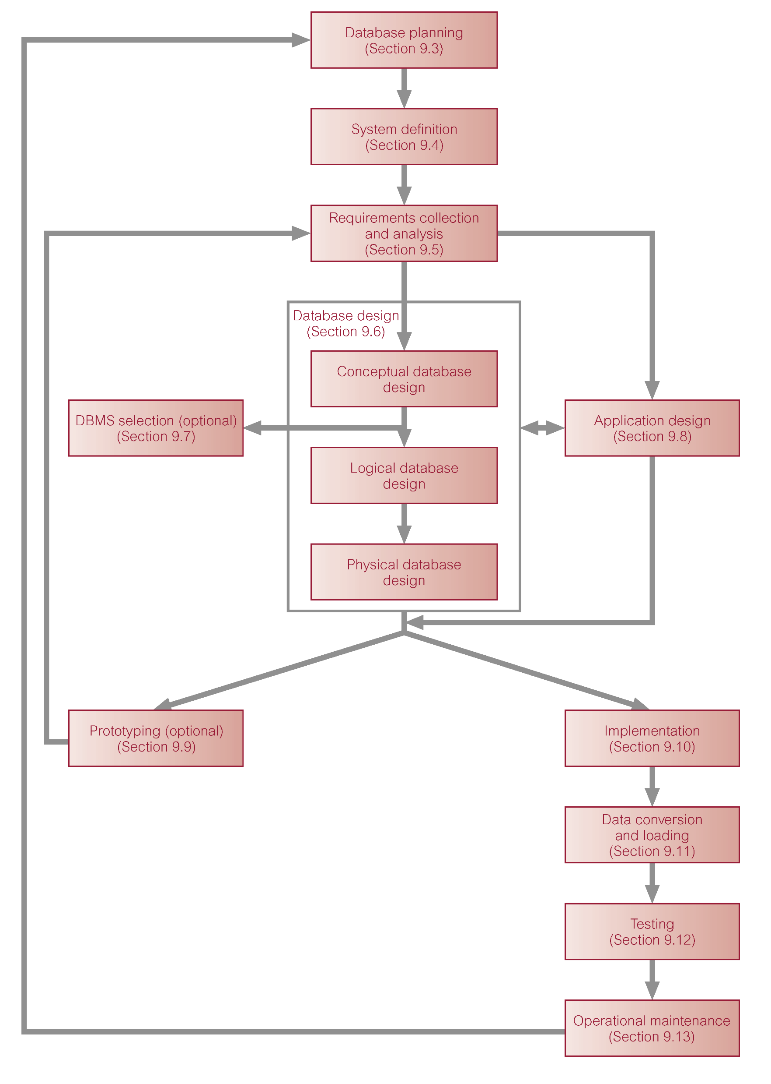
Stages of the Database Systems Development Lifecycle

Slide 7
Database Planning
Management activities that allow stages of database application lifecycle to be realized as efficiently and effectively, as possible.
Must be integrated with overall IS strategy of the organization.

Slide 8
Database Planning … Mission Statement
Mission statement for the database project defines major aims of database application.
Those driving database project normally define the mission statement.
Mission statement helps clarify purpose of the database project and provides clearer path towards the efficient and effective creation of required database application.

Slide 9
Database Planning … Mission Objectives
Once mission statement is defined, mission objectives are defined.
Each objective should identify a particular task that the database must support.
May be accompanied with some additional information that specifies the work to be done, the resources with which to do it, and the money to pay for it all.

Slide 10
Database Planning…
Database planning should also include development of standards that govern:
  how data will be collected,
  how the format should be specified,
  what necessary documentation will be needed,
  how design and implementation should proceed.

Slide 11
System Definition
Describes scope and boundaries of database application and the major user views.
User view defines what is required of a database application from perspective of:
  a particular job role (such as Manager or Supervisor) or
  enterprise application area (such as marketing, personnel, or stock control).

Slide 12
System Definition…
Database application may have one or more user views.
Identifying user views helps ensure that no major users of the database are forgotten when developing requirements for new application.
User views also help in development of complex database application allowing requirements to be broken down into manageable pieces.

Slide 13
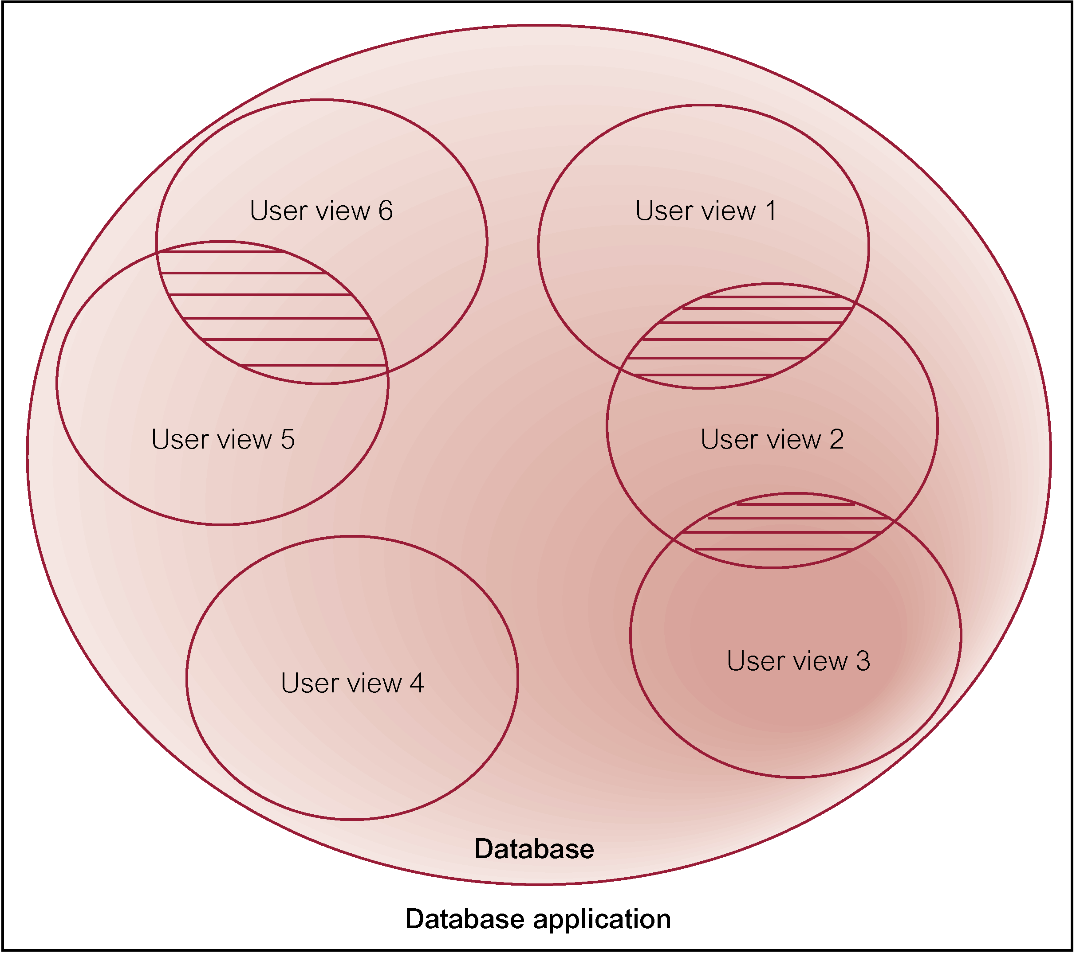
Representation of a database application with multiple user views

Slide 14
Requirements Collection and Analysis
Process of collecting and analyzing information about the part of organization to be supported by the database application, and using this information to identify users’ requirements of new system.

Slide 15
Requirements Collection and Analysis…
Information is gathered for each major user view including:
  a description of data used or generated
  details of how data is to be used/generated
  any additional requirements for new database application.
Information is analyzed to identify requirements to be included in new database application.

Slide 16
Requirements Collection and Analysis…
Another important activity is deciding how to manage database application with multiple user views.
Three main approaches:
  centralized approach
  view integration approach
  combination of both approaches.

Slide 17
Database Design
Process of creating a design for a database that will support the enterprise’s operations and objectives.

Slide 18
Database Design…
Major aims:
  Represent data and relationships between data required by all major application areas and user groups.
  Provide data model that supports any transactions required on the data.
  Specify a minimal design that is appropriately structured to achieve stated performance requirements for the system (such as response times).

Slide 19
Database Design…
Approaches include:
  Top-down
  Bottom-up
  Inside-out
  Mixed

Slide 20
Database Design…
Main purposes of data modeling include:
  to assist in understanding the meaning (semantics) of the data
  to facilitate communication about the information requirements.
Building data model requires answering questions about entities, relationships, and attributes.

Slide 21
Database Design…
A data model ensures we understand:
  - each user’s perspective of the data;
  - nature of the data itself, independent of its physical representations;
  - use of data across user views.

Slide 22
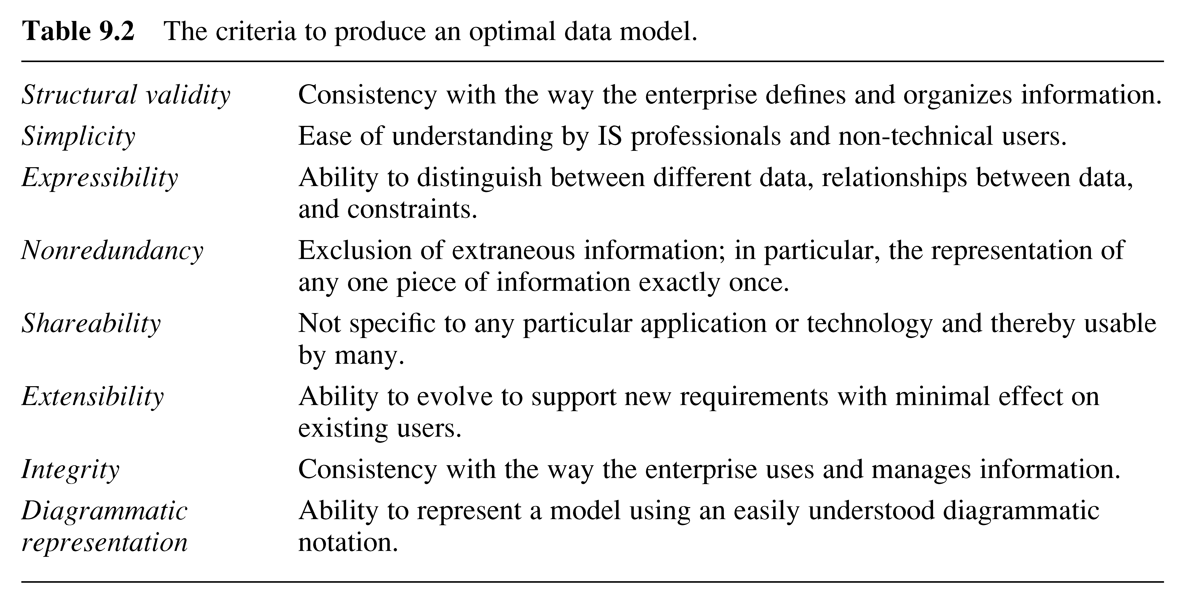
Criteria to produce an optimal data model

Slide 23
Database Design
Three phases of database design:
  Conceptual database design
  Logical database design
  Physical database design.

Slide 24
Conceptual Database Design
Process of constructing a model of the information used in an enterprise, independent of all physical considerations.
Data model is built using the information in users’ requirements specification.
Source of information for logical design phase.

Slide 25
Logical Database Design
Process of constructing a model of the information used in an enterprise based on a specific data model (e.g. relational), but independent of a particular DBMS and other physical considerations.
Conceptual data model is refined and mapped on to a logical data model.

Slide 26
Physical Database Design
Process of producing a description of the database implementation on secondary storage.
Describes storage structures and access methods used to achieve efficient access to data.
Tailored to a specific DBMS system.

Slide 27
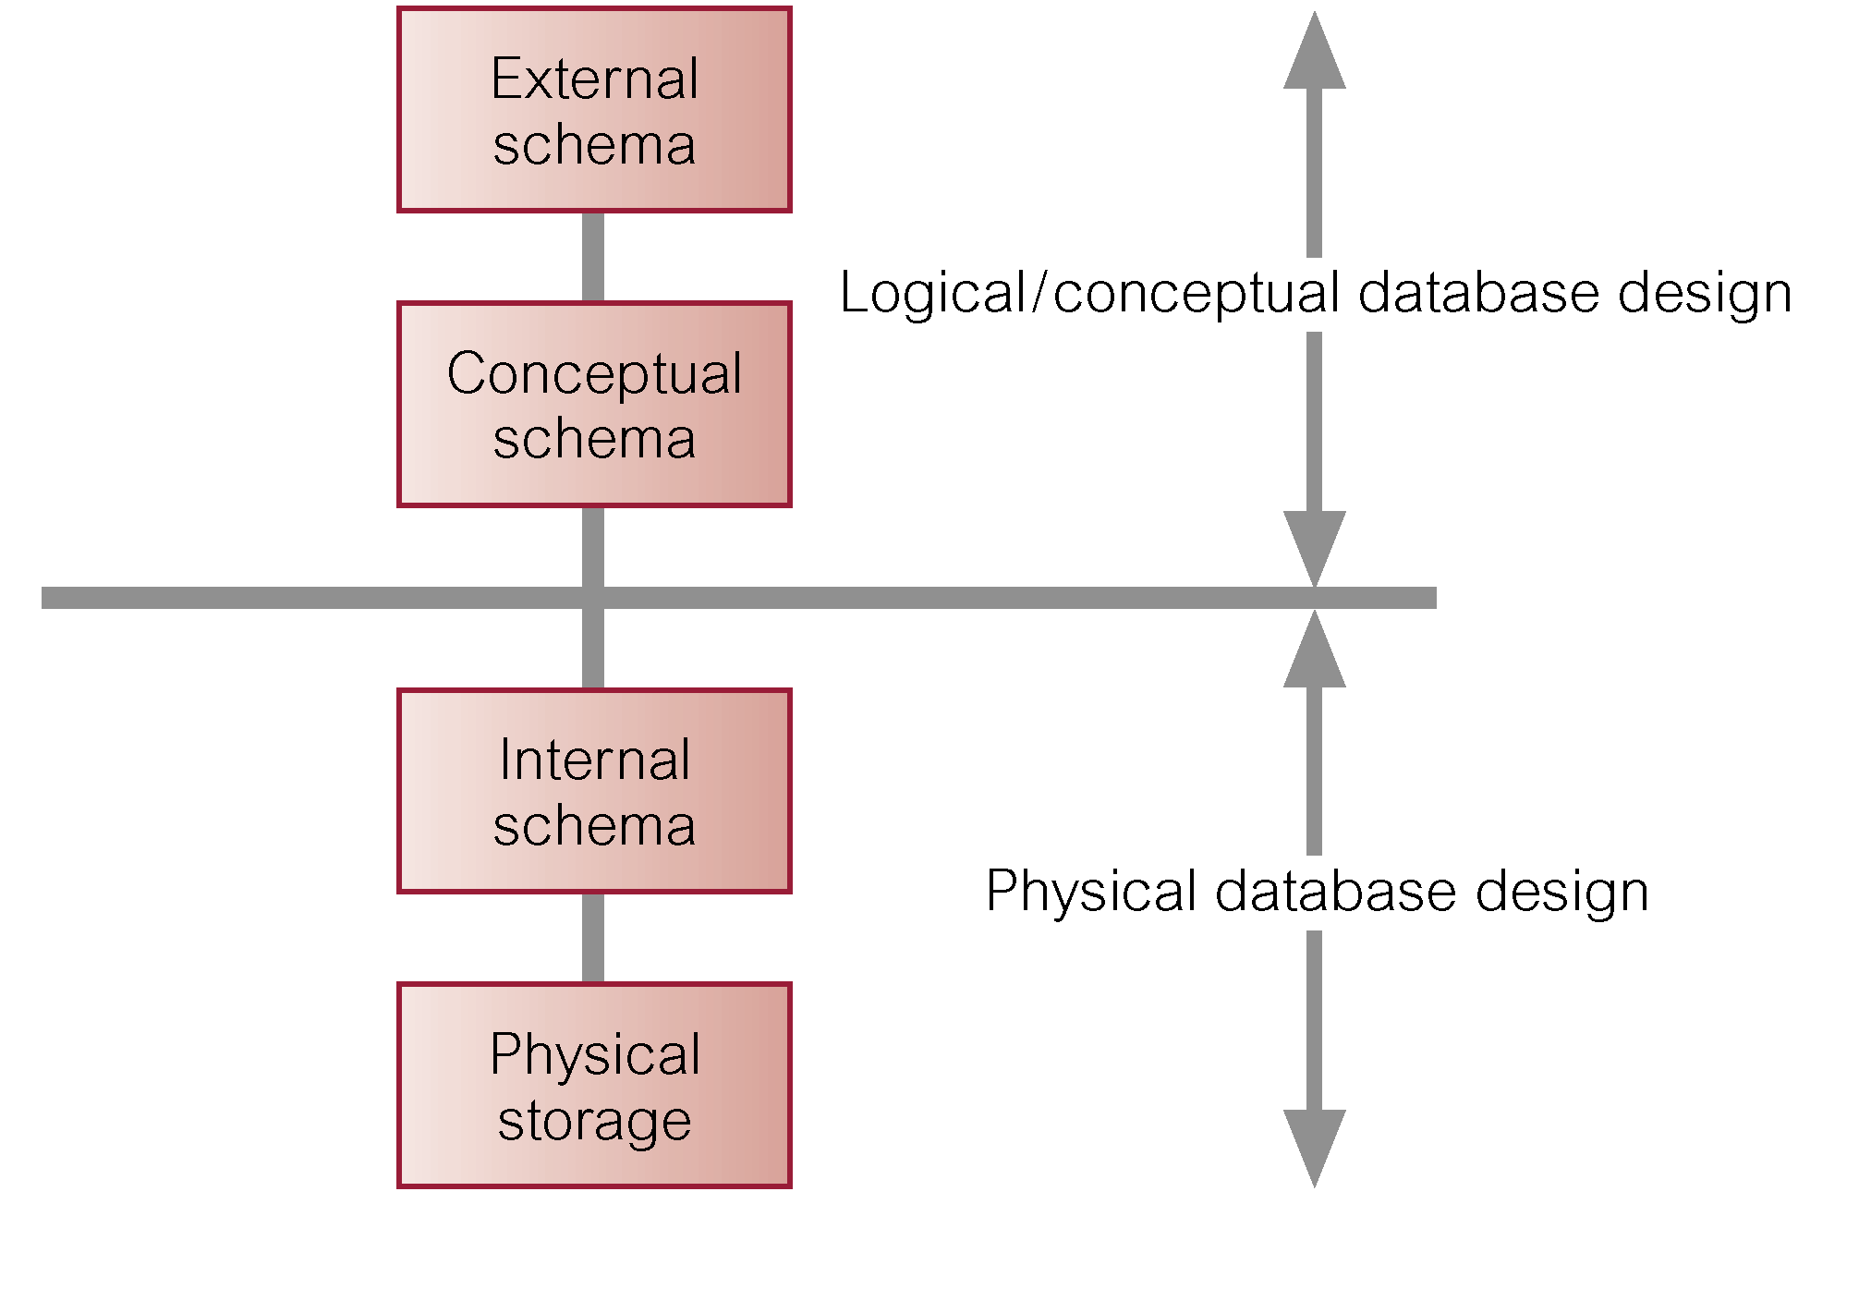
Three-level ANSI-SPARC architecture and phases of database design

Slide 28
DBMS Selection
Selection of an appropriate DBMS to support the database application.
Undertaken at any time prior to logical design provided sufficient information is available regarding system requirements.
Main steps to selecting a DBMS:
  define Terms of Reference of study
  shortlist two or three products
  evaluate products
  recommend selection and produce report.

Slide 29
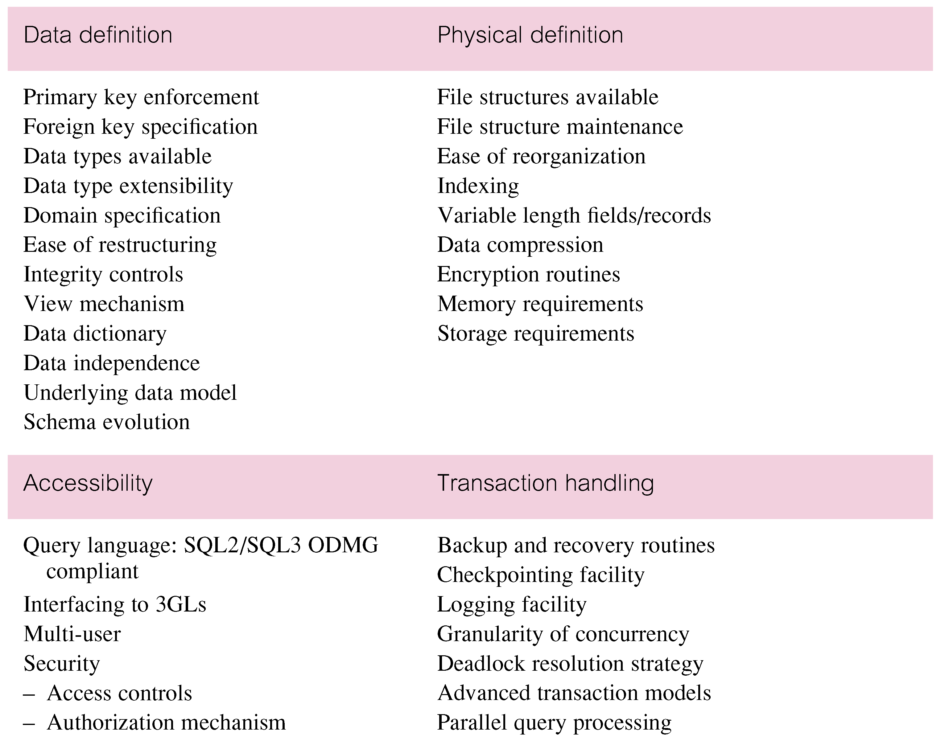
DBMS Evaluation Features

Slide 30
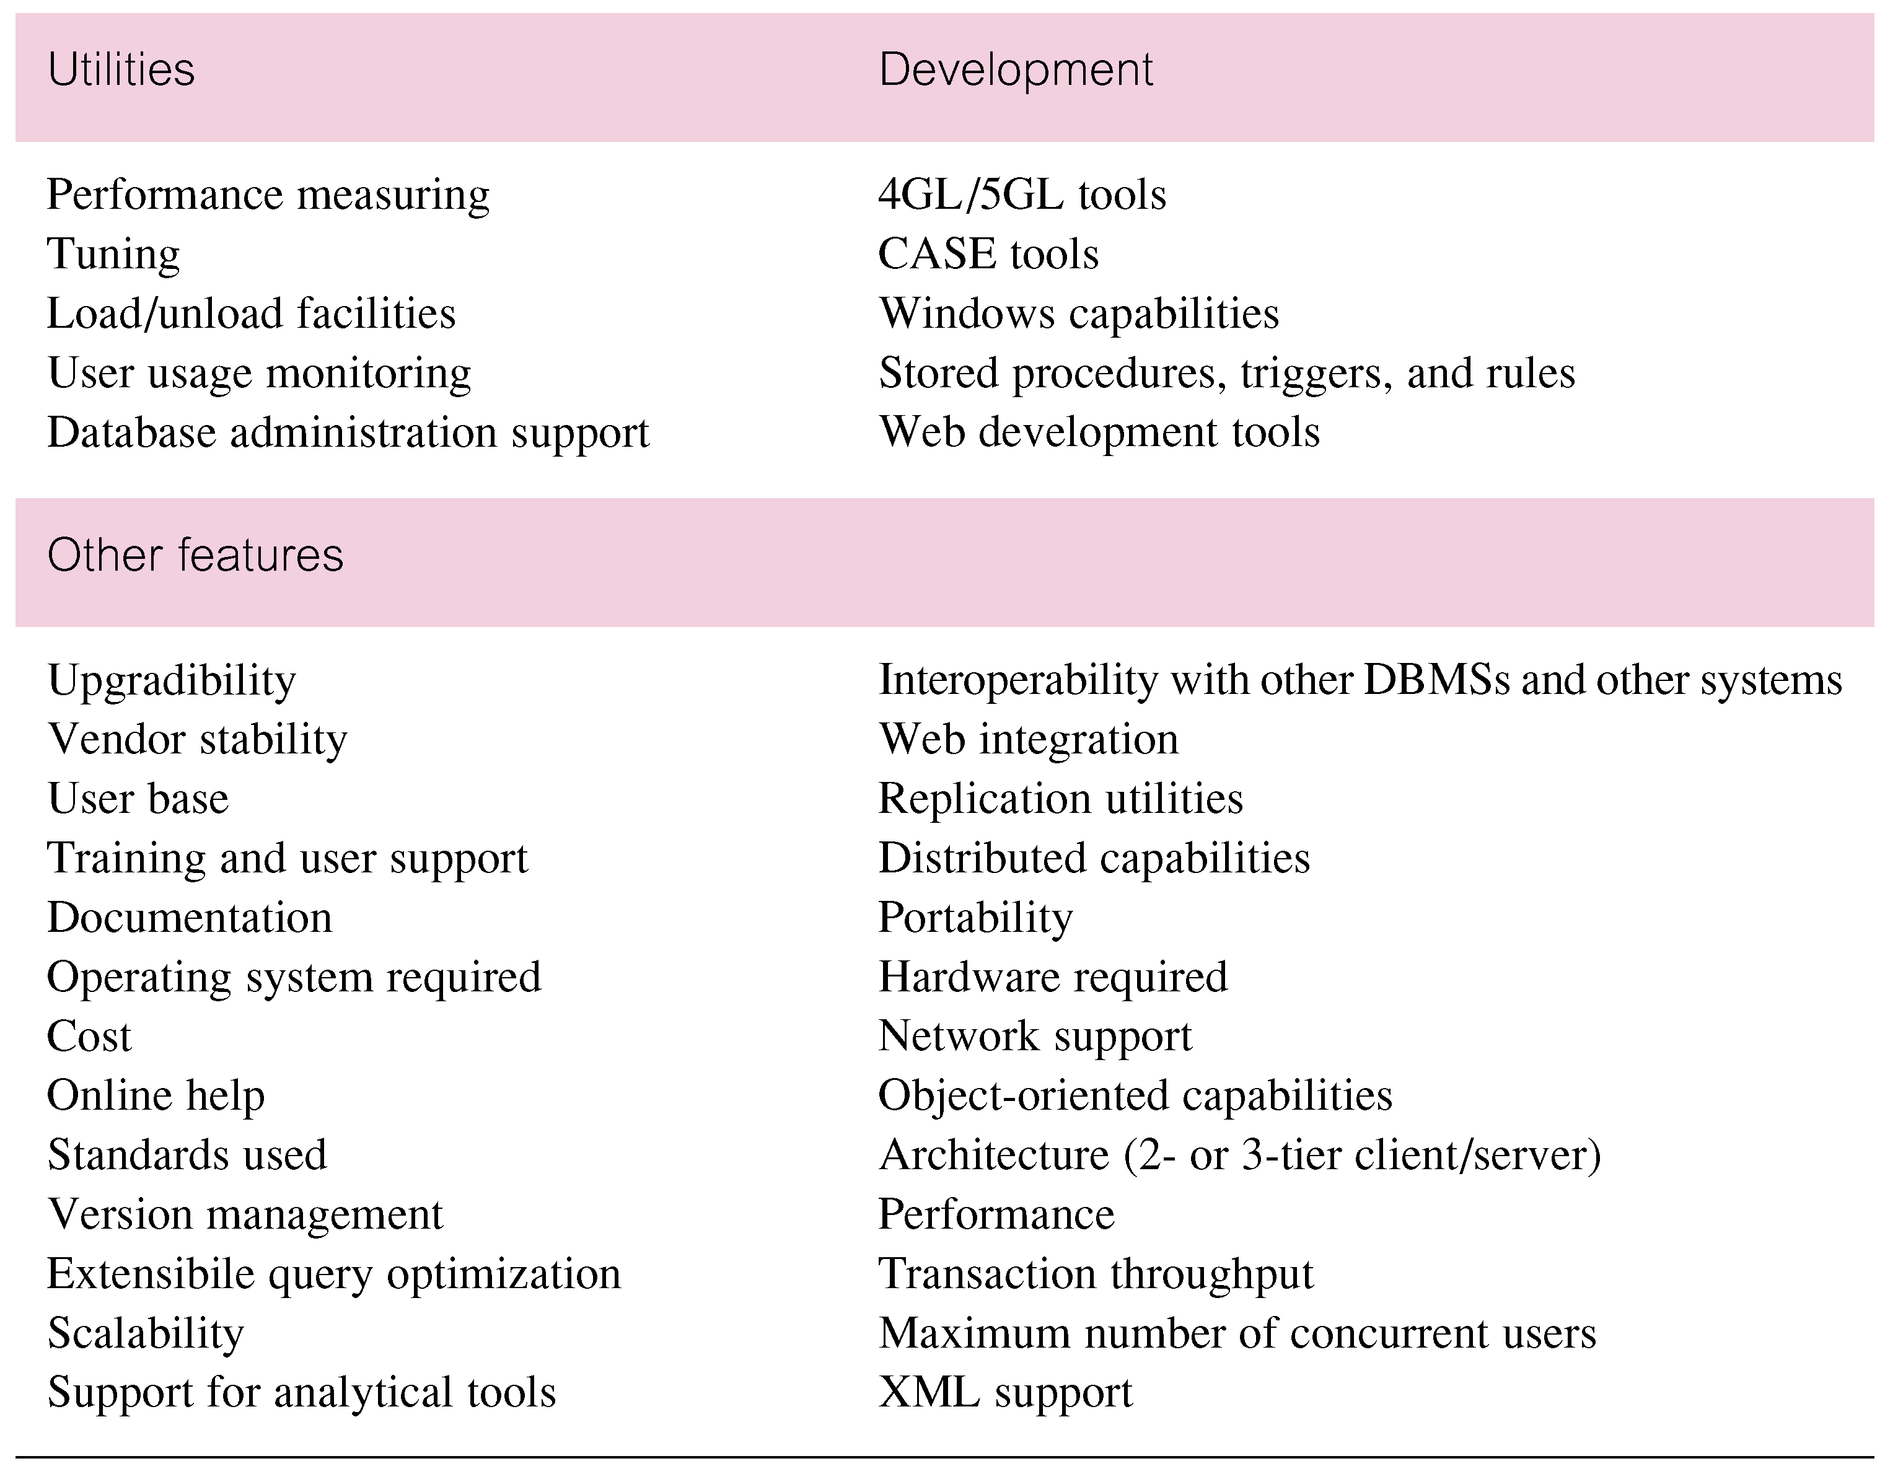
DBMS Evaluation Features

Slide 31
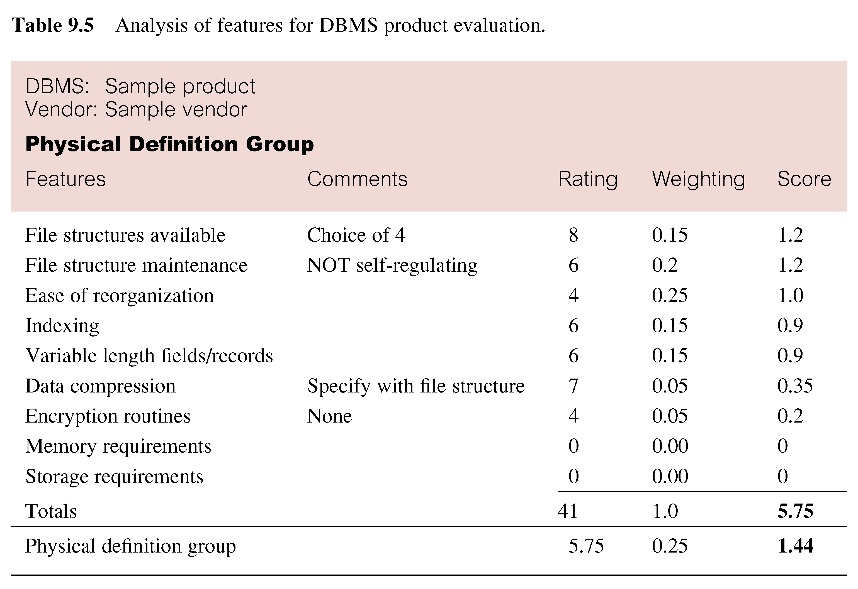
Example - Evaluation of DBMS Product

Slide 32
Application Design
Design of user interface and application programs that use and process the database.
Database and application design are parallel activities.
Includes two important activities:
  transaction design;
  user interface design.

Slide 33
Application Design … Transactions
An action, or series of actions, carried out by a single user or application program, which accesses or changes content of the database.
Purpose to define and document the high-level characteristics of the transactions required.

Slide 34
Application Design … Transactions
Important characteristics of transactions:
  data to be used by the transaction
  functional characteristics of the transaction
  output of the transaction
  importance to the users
  expected rate of usage.
Three main types of transactions: retrieval, update and mixed.

Slide 35
Prototyping
Building working model of a database application.
Purpose
  to identify features of a system that work well, or are inadequate
  to suggest improvements or even new features
  to clarify the users’ requirements
  to evaluate feasibility of a particular system design.

Slide 36
Implementation
Physical realization of the database and application designs.
  Use DDL to create database schemas and empty database files.
  Use DDL to create any specified user views.
  Use 3GL or 4GL to create application programs, including database transactions, created using DML possibly embedded in a host programming language.

Slide 37
Data Conversion and Loading
Transferring any existing data into new database and converting any existing applications to run on new database.
Only required when new database system is replacing an old system.
  DBMS normally has utility that loads existing files into new database.
May be possible to convert and use application programs from old system for use by new system.

Slide 38
Testing
Process of executing application programs with intent of finding errors.
Use carefully planned test strategies and realistic data.
Testing cannot show absence of faults; it can show only that software faults are present.
Demonstrates that database and application programs appear to be working according to requirements.

Slide 39
Operational Maintenance
Process of monitoring and maintaining system following installation.
Monitoring performance of system.
  if performance falls, may require tuning or reorganization of the database.
Maintaining and upgrading database application (when required).
Incorporating new requirements into database application.

Slide 40
Data Administration and Database Administration
Data Administrator (DA) and Database Administrator (DBA) are responsible for managing and controlling activities associated with corporate data and corporate database, respectively.
DA is more concerned with early stages of lifecycle and DBA is more concerned with later stages.

Slide 41
Data Administration
Management of data resource including:
  database planning,
  development and maintenance of standards, policies and procedures, and conceptual and logical database design.

Slide 42
Database Administration
Management of physical realization of a database application including:
  physical database design and implementation,
  setting security and integrity controls,
  monitoring system performance, and reorganizing the database.

Slide 43
Read About the Following:
(Chapter 9, 10 and 11)
Chapter 9: What are Computer Aided Software Engineering (CASE) Tools?
Benefits of CASE tools in database design and development?
Chapter 10: Facts Finding; Type of Facts Collected (Output) in each stage of (DSDLC), Documentation, Application, and Commonly used fact finding techniques,
Chapter 11: Entity Relationship Modelling (ER) in database design, basic concepts of ER model; entities, attributes, relationships, Unified Modeling Language (UML).
Recall Knowledge of ; Systems Analysis & Design Course*

